Slide 1
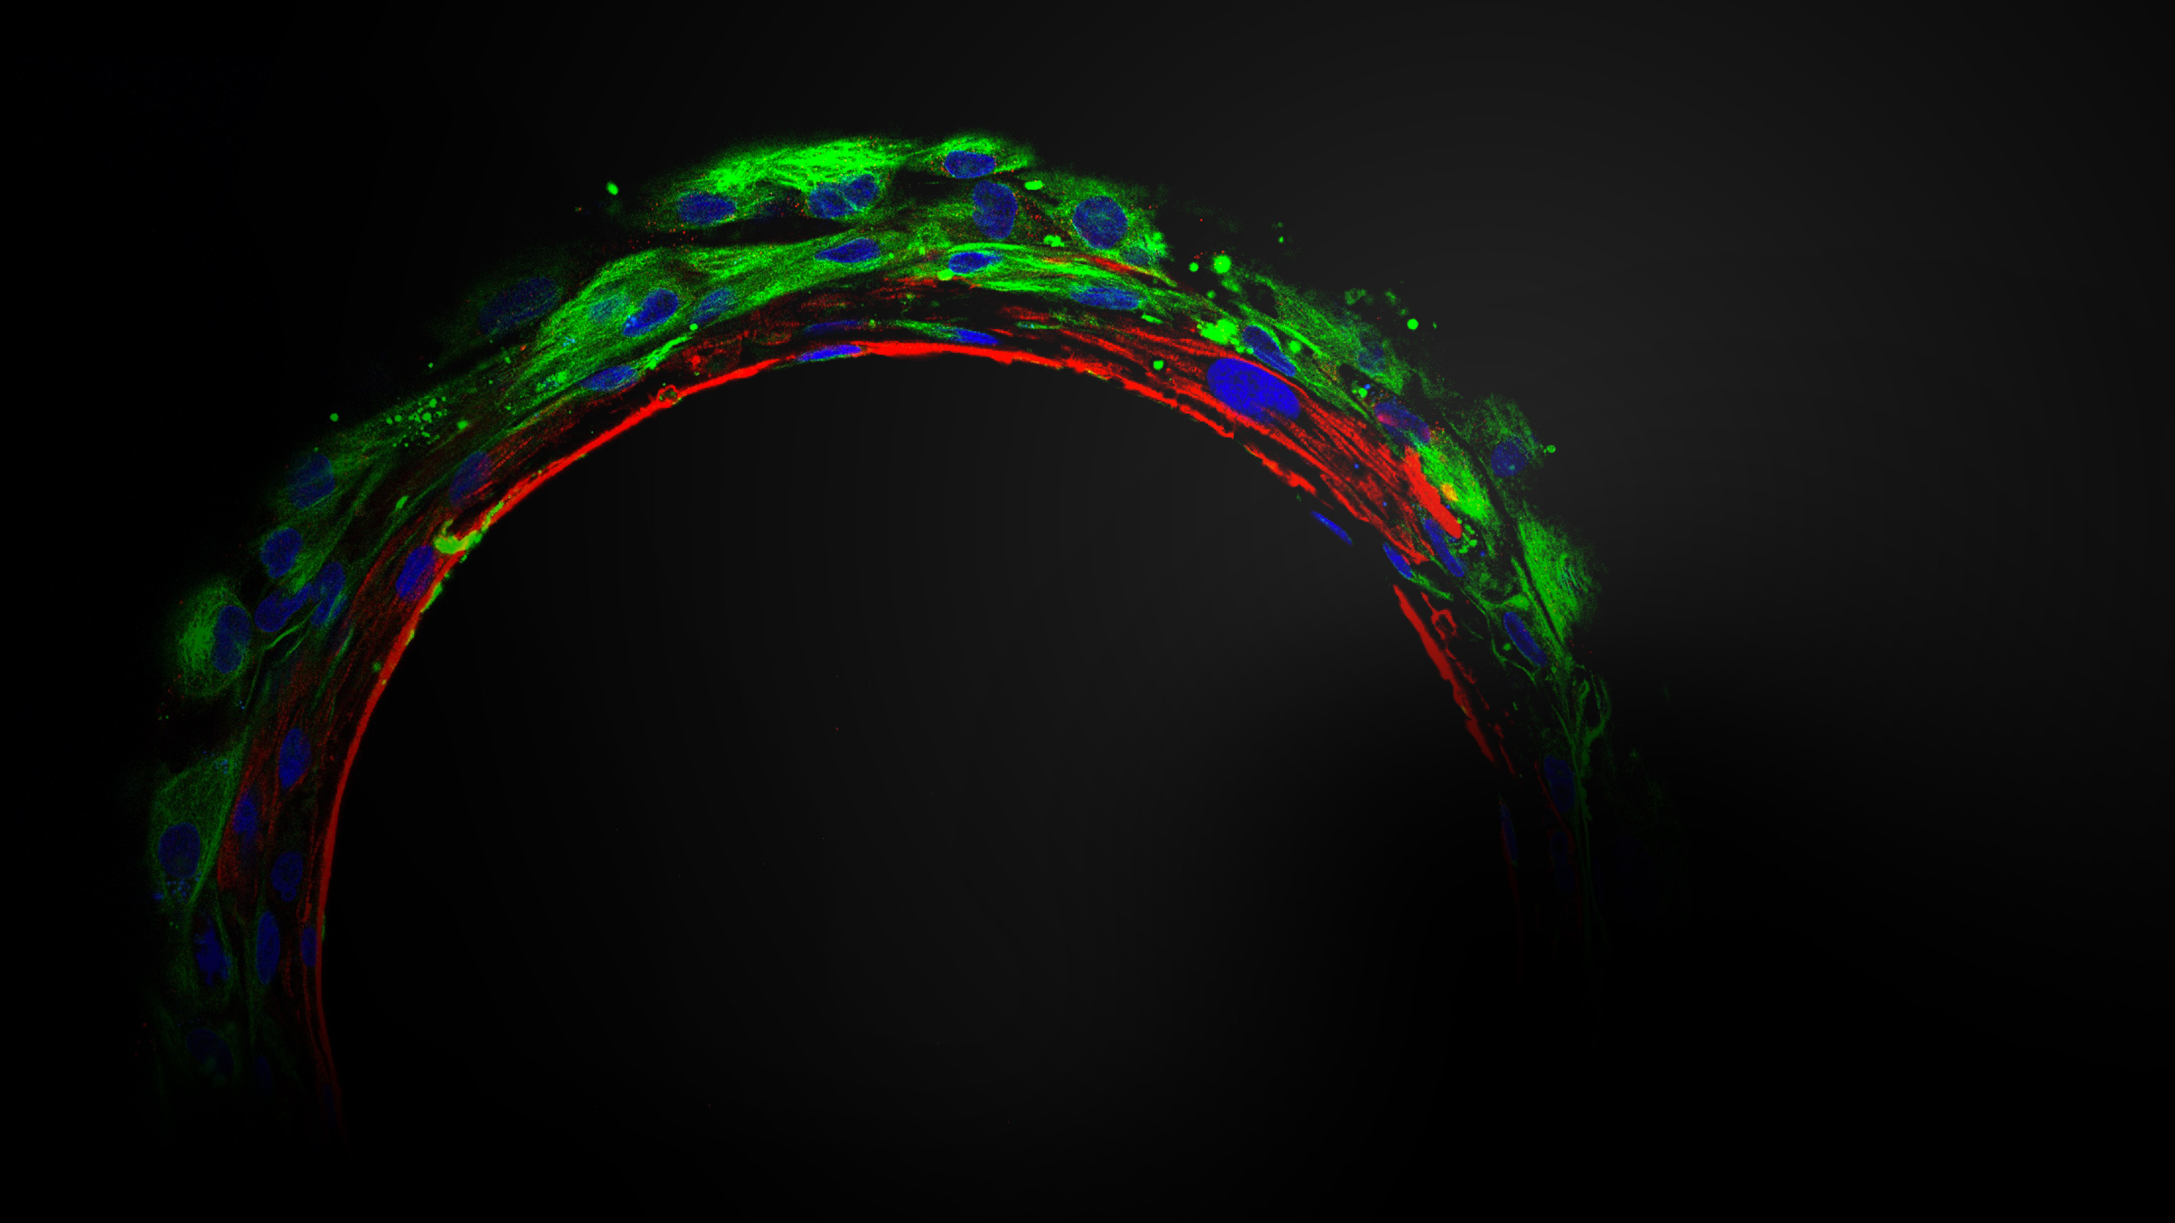
SmartHeart Platform
Advancing Cardiac Safety and efficacy through 3D Human Microtissues

Slide 2

Versatile hydrogel-based technology to form organoids and microtissues

Slide 3
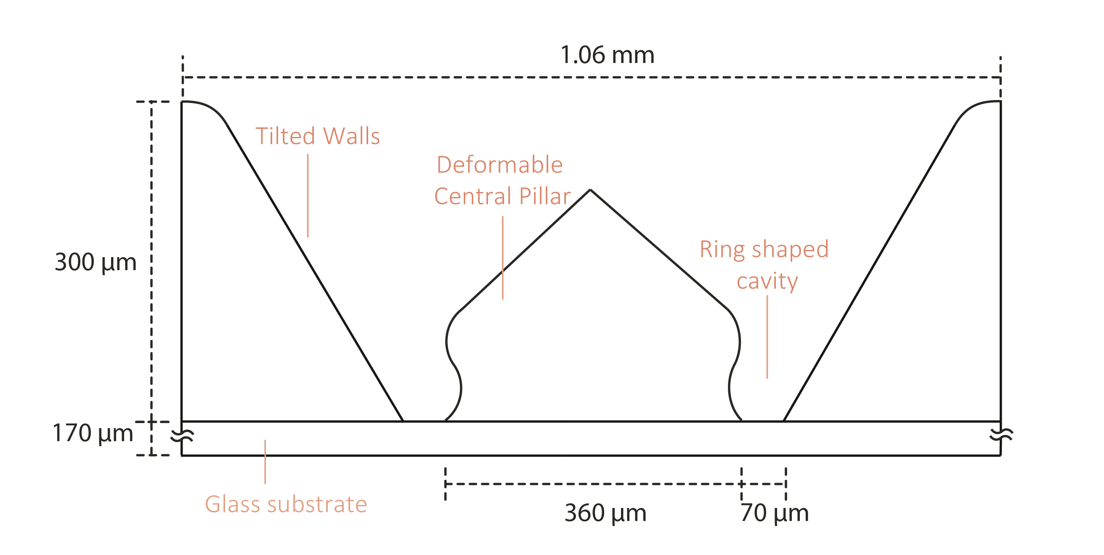
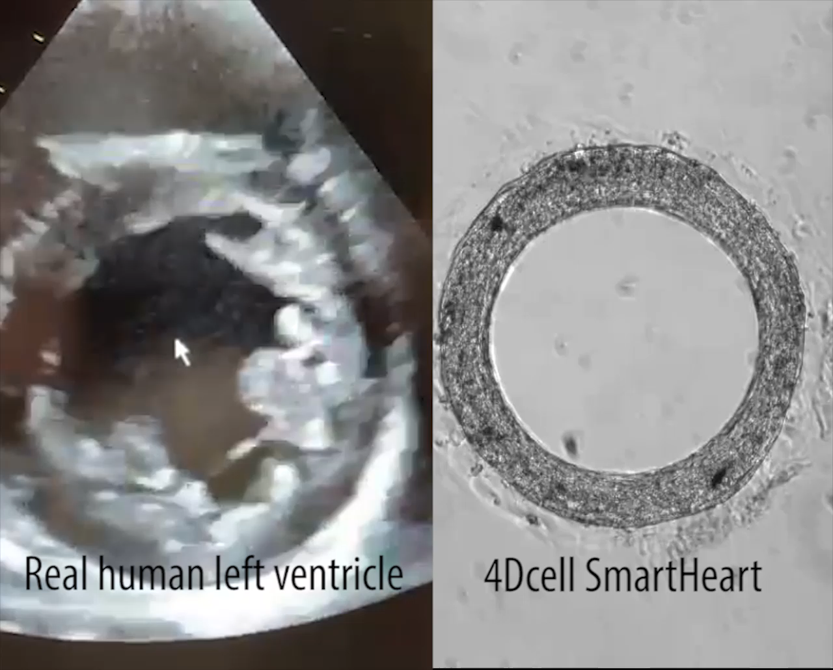
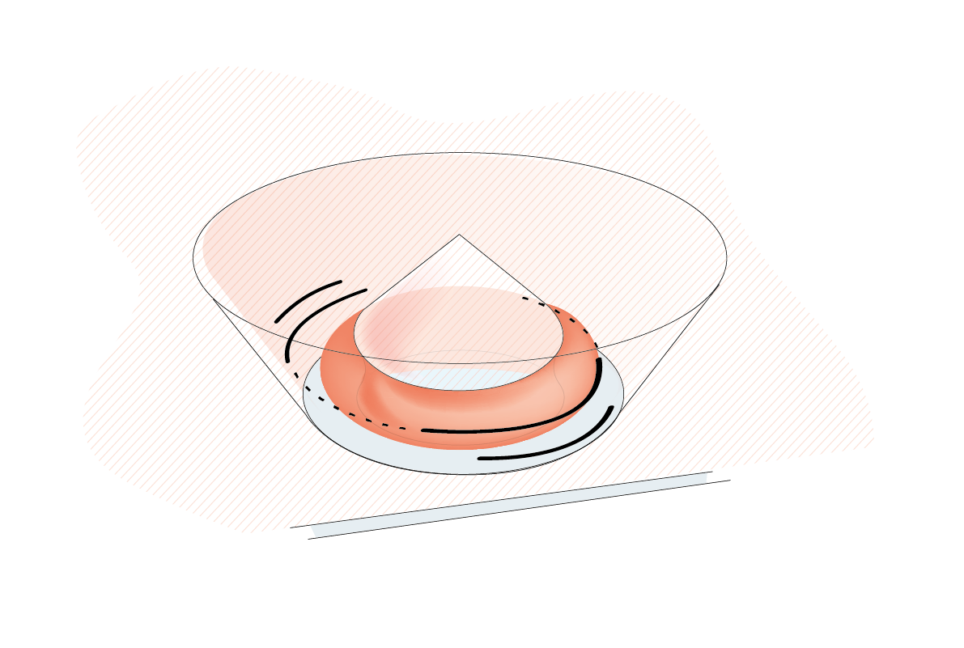

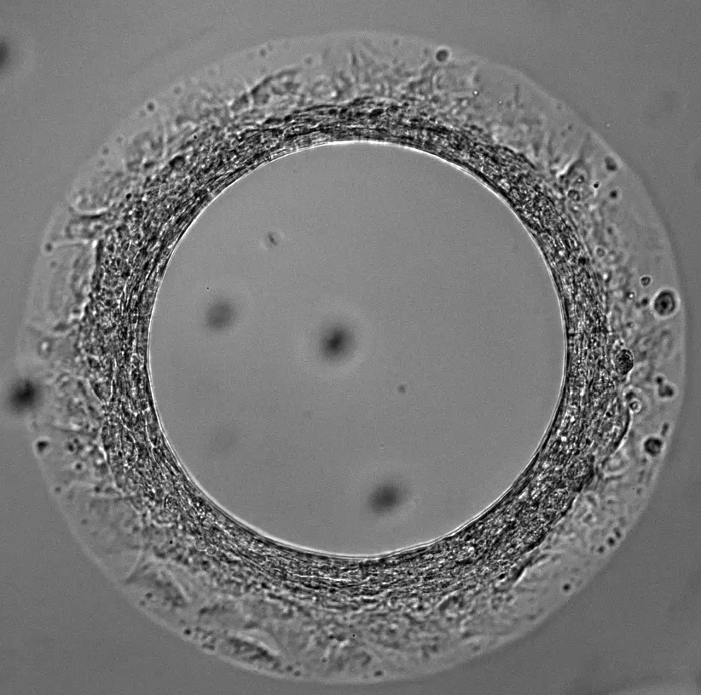
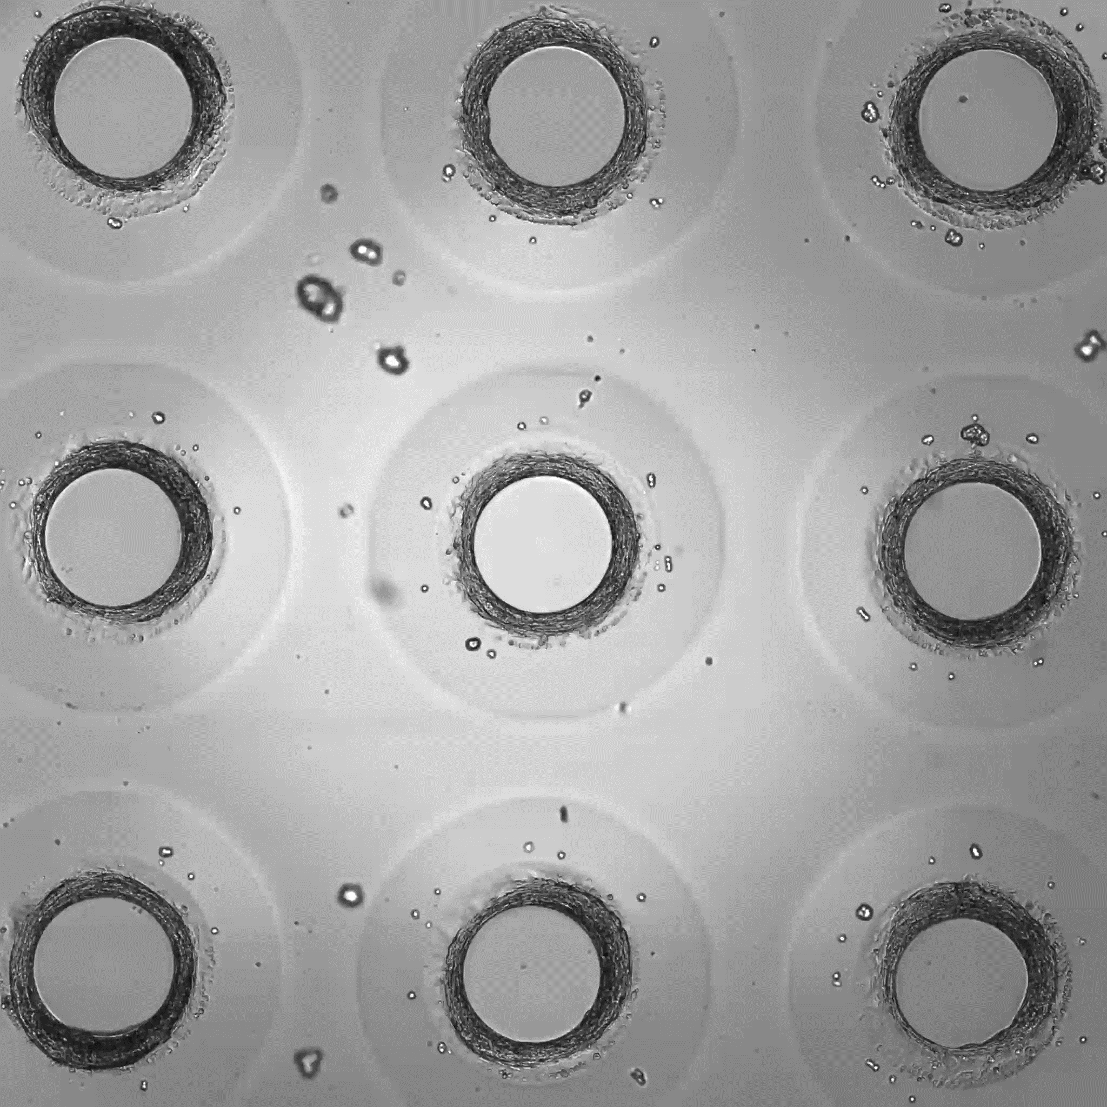
The SmartHeart Platform [Engineered plate + Protocol + Software]
Precisely defined stiffness (5 kPa to 20 kPa) ensures physiological relevance and accurate force measurements
Circular geometry ensures a morphology resembling the human left ventricle
Ring shaped cavities made of non-adhesive biocompatible hydrogel (polyethylene glycol-based hydrogel)
Compatible with pacing systems
iPSC-Cardiomyocytes & fibroblasts
Hourglass (s-shaped) pillar and glass bottom ensures anchoring and reproducible localization of the tissues
#1.5 glass bottom: in-situ high-resolution imaging & and live-cell video recording (brightfield and fluorescence)
High Throughput – 9 replicates per well in a 96 well plate format

Slide 4
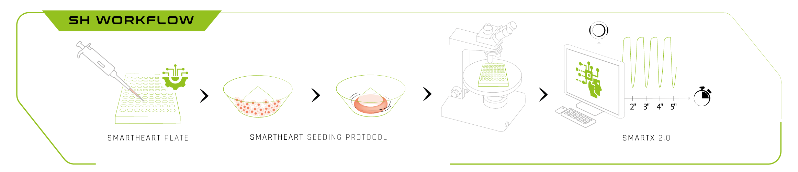
An easy and straightforward workflow

Slide 5
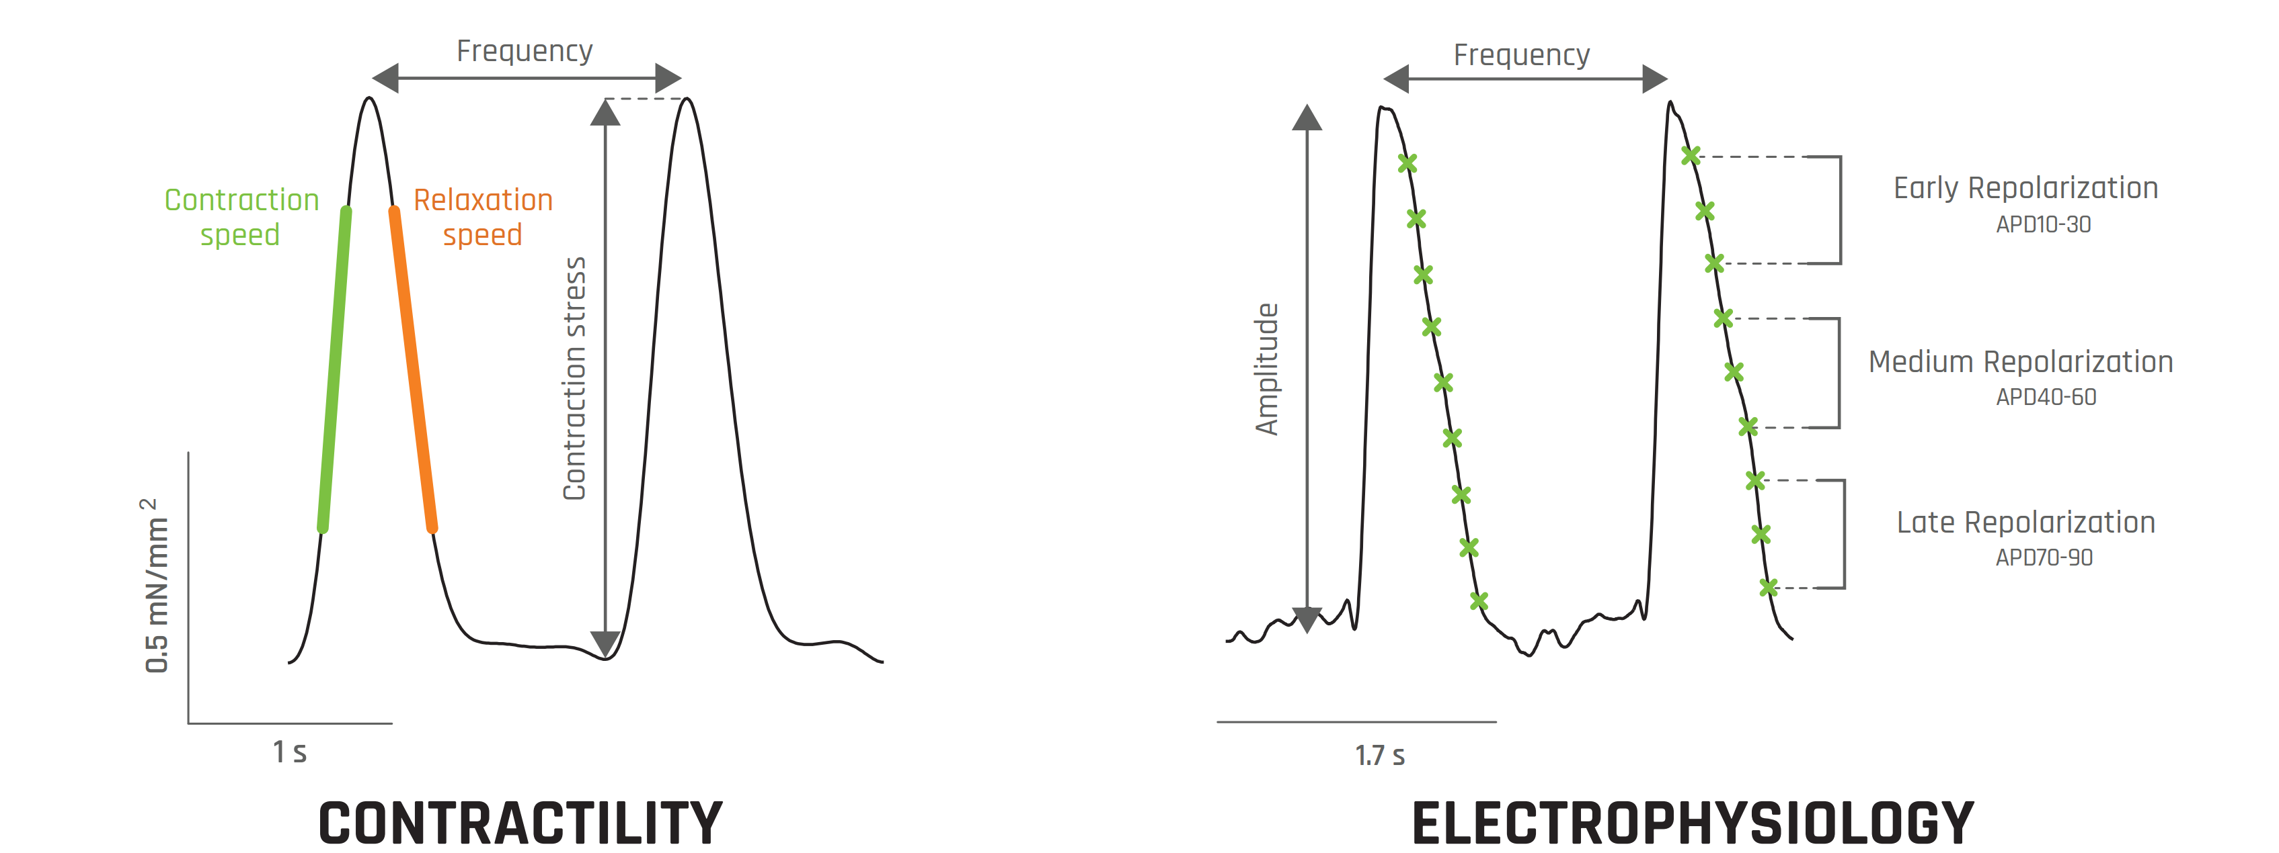
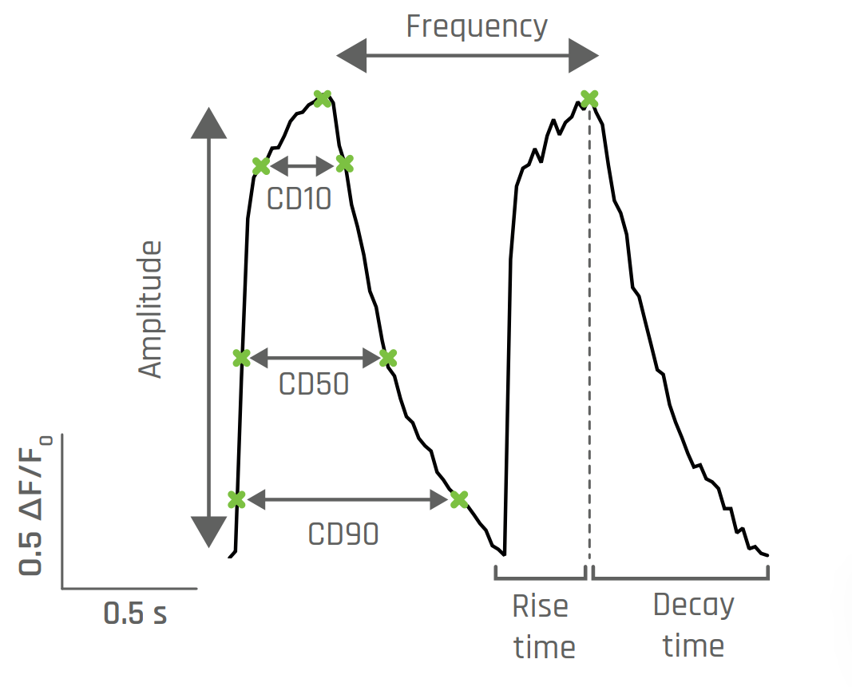
3 in 1 assay
In situ acquisition of contractility, electrophysiology and calcium metrics
CONTRACTILITY METRICS
Contraction Stress
Contraction Strain
Beating frequency
Contraction and Relaxation speed
ACTION POTENTIAL METRICS
      Frequency
      Interpeak duration STD
      Rise time, upstroke velocity
      Triangulation & plateau duration
        APD10-90
CALCIUM METRICS
      Frequency
      Area under curve
      Rise & decay duration & velocity
        CD10,50,90

Slide 6

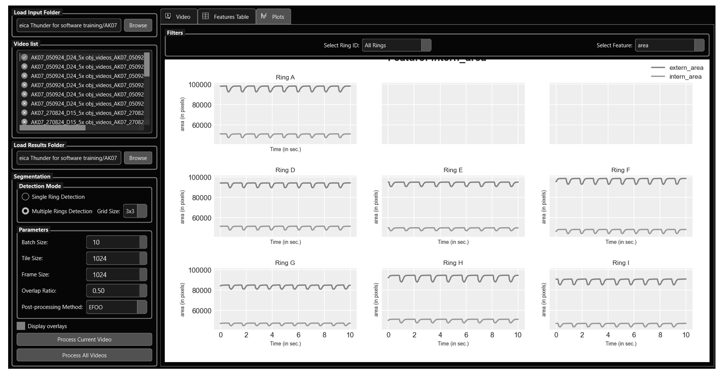
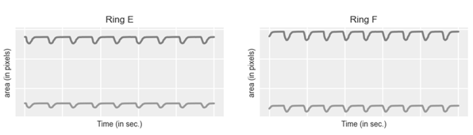
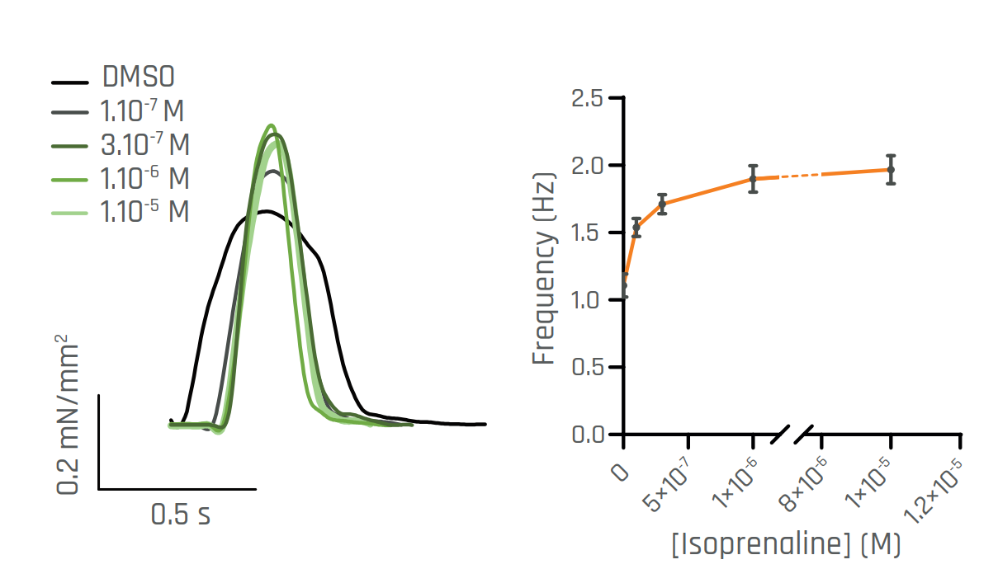
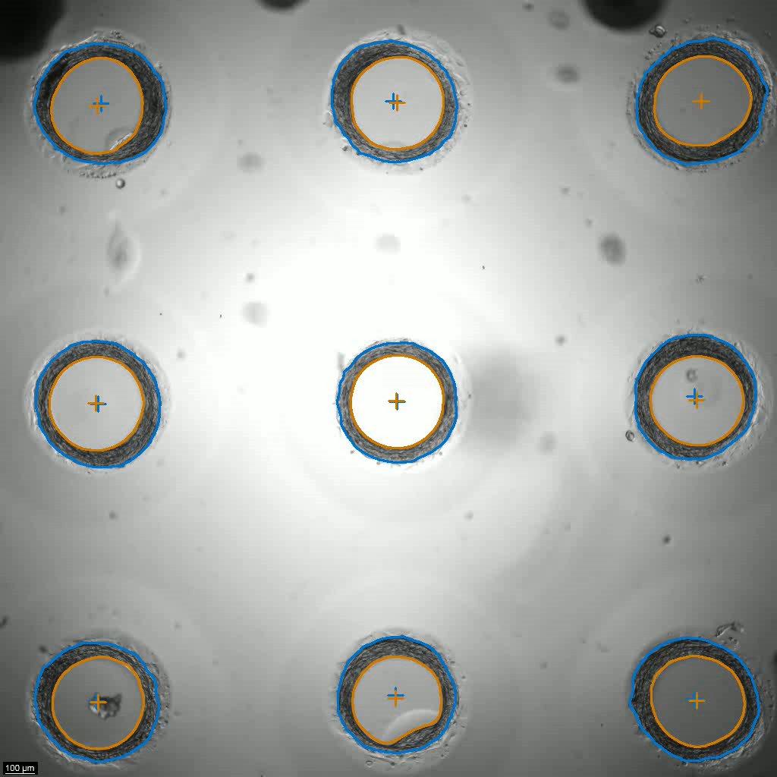
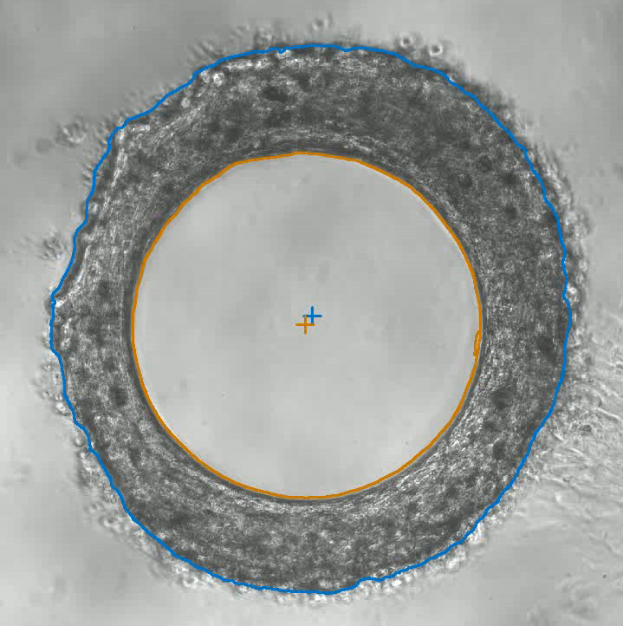
Imaged based contractility assessment
SmartX 2.0 - AI based software that detects and tracks the tissues enabling to quantify the contractility metrics
Isoproterenol
Agonist of the beta-adrenergic receptors
Positive inotropic response + Positive chronotropic response
Positive force- frequency relationship not observed in 2D
CONTRACTILITY

Slide 7
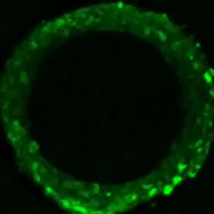
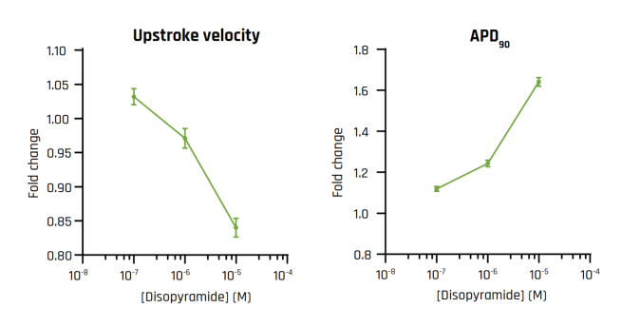
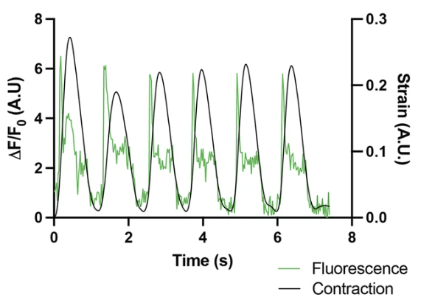
Imaged based electrophysiology assessment - voltage sensitive dyes
Disopyramide
Sodium channel blocker & moderate blockade of potassium channels
Decrease in upstroke velocity
Prolongation in late APDs
ACTION POTENTIAL
Excitation contraction coupling
Seguret et al (2023) A versatile high-throughput assay based on 3D ring-shaped cardiac tissues generated from human induced pluripotent stem cell derived cardiomyocytes eLife 12:RP87739
Notes:
20 fps
512*512

Slide 8
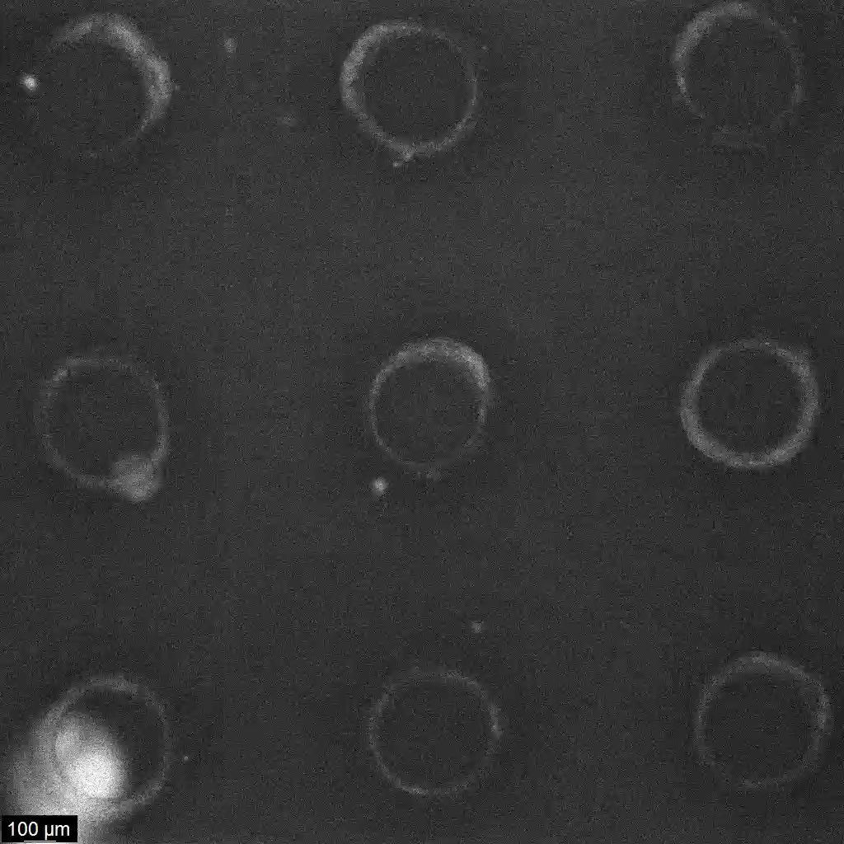
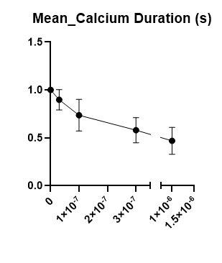
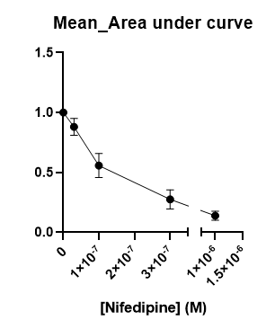
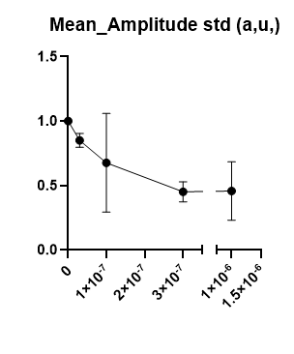
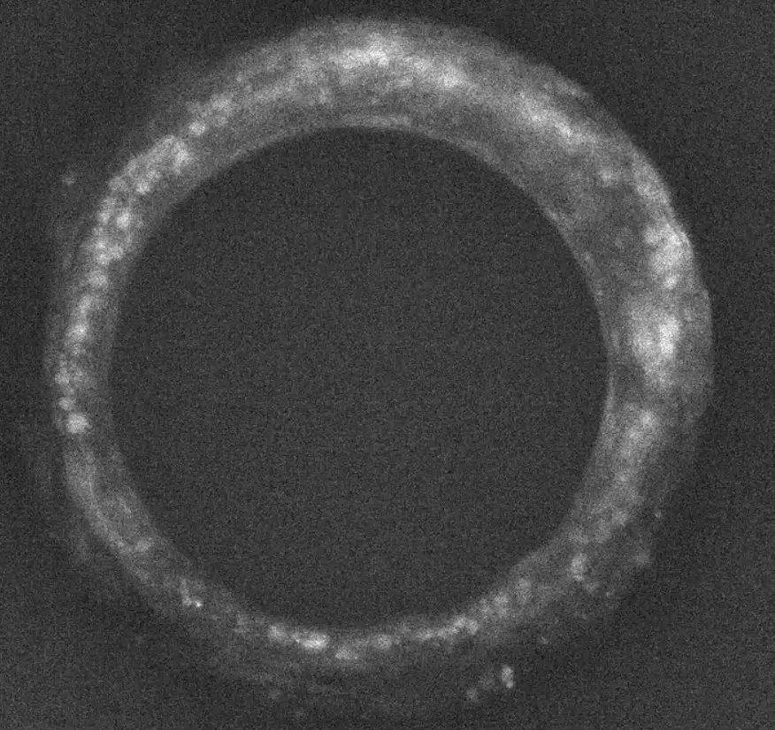
Imaged based calcium assessment
Nifedipine
L-type calcium channel (LTCC) blocker medication
Decreased calcium transient amplitude, area under curve and duration
CALCIUM TRANSIENT
Cal520 am
Notes:
20 fps
512*512
Measurement focuses on the amplitude (peak calcium concentration), frequency (how often transients occur), and kinetics (rise and decay times), which provide insight into the dynamics of calcium signaling during excitation–contraction coupling.

Slide 9
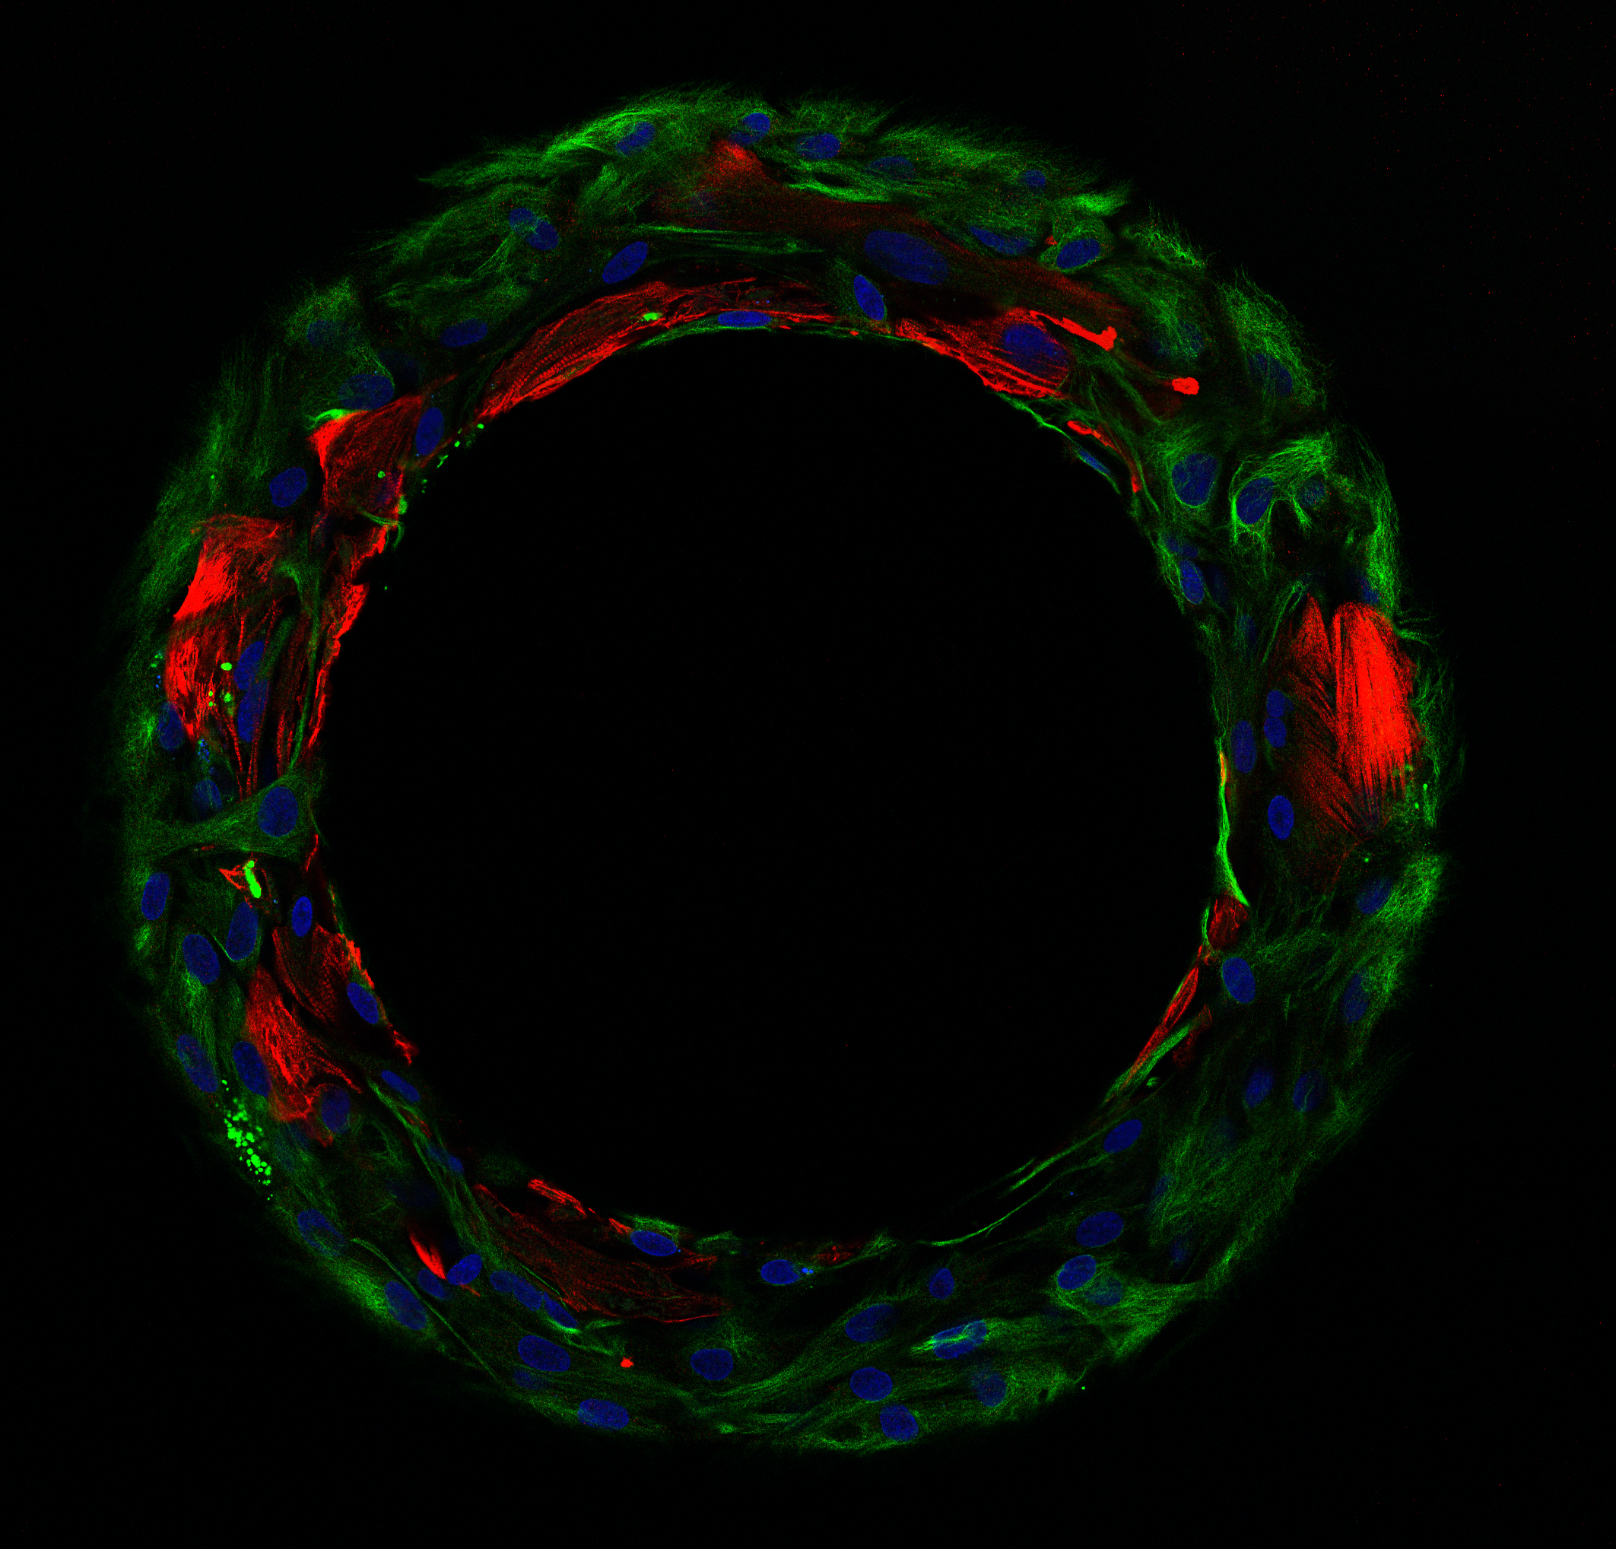
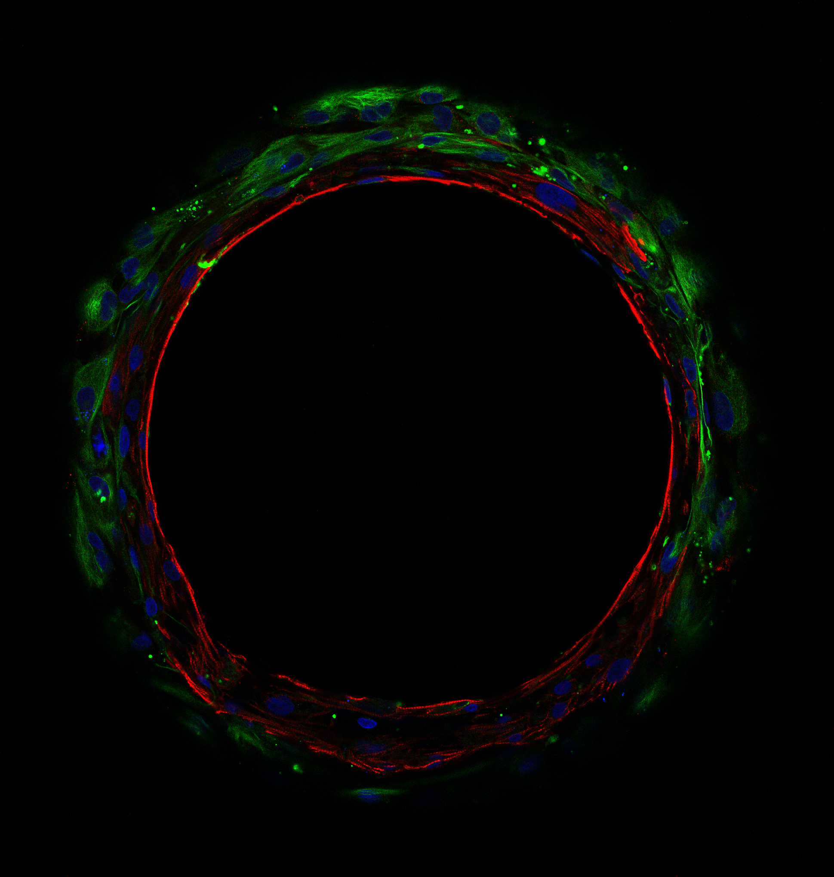
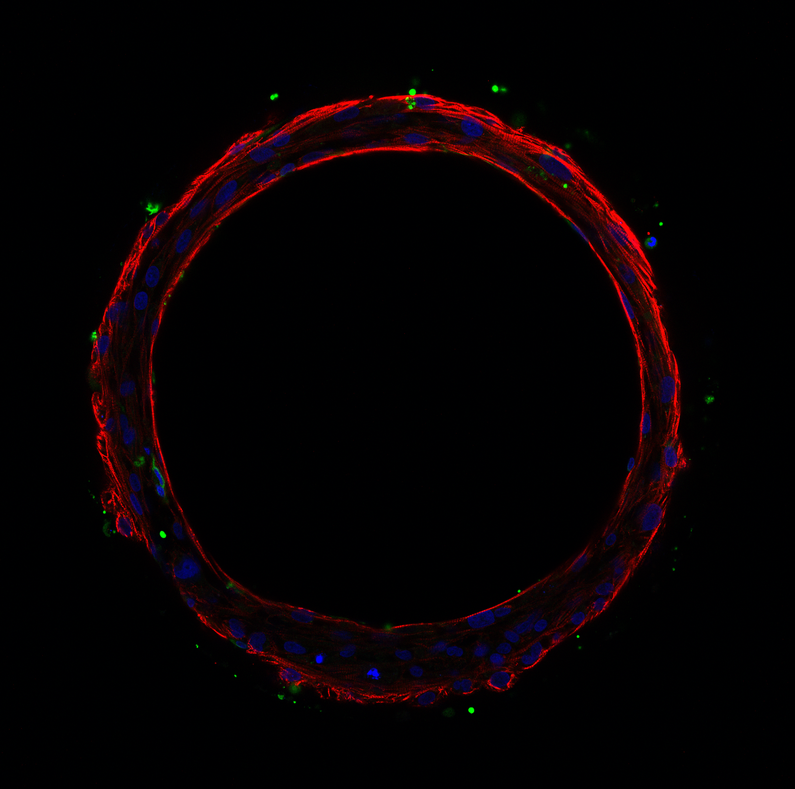
Morphology of the tissues
Cardiac tissue
Basal layer of fibroblasts
Troponin T / Vimentin / DAPI
Seguret et al (2023) A versatile high-throughput assay based on 3D ring-shaped cardiac tissues generated from human induced pluripotent stem cell derived cardiomyocytes eLife 12:RP87739

Slide 10
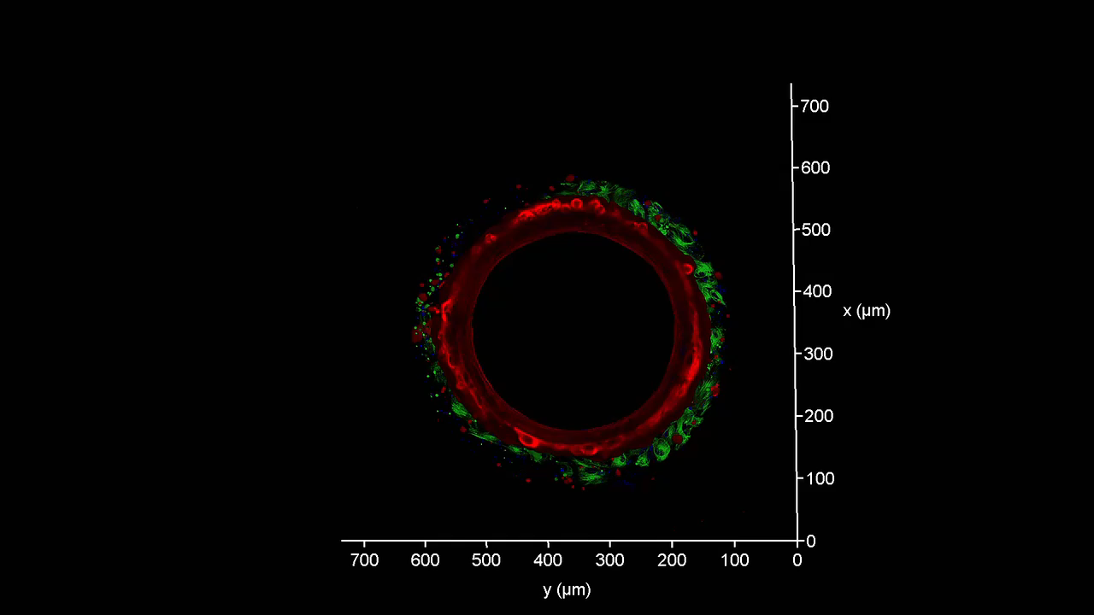
3D reconstruction of a ring-shaped cardiac tissue
Troponin T / Vimentin / DAPI
Seguret et al (2023) A versatile high-throughput assay based on 3D ring-shaped cardiac tissues generated from human induced pluripotent stem cell derived cardiomyocytes eLife 12:RP87739

Slide 11
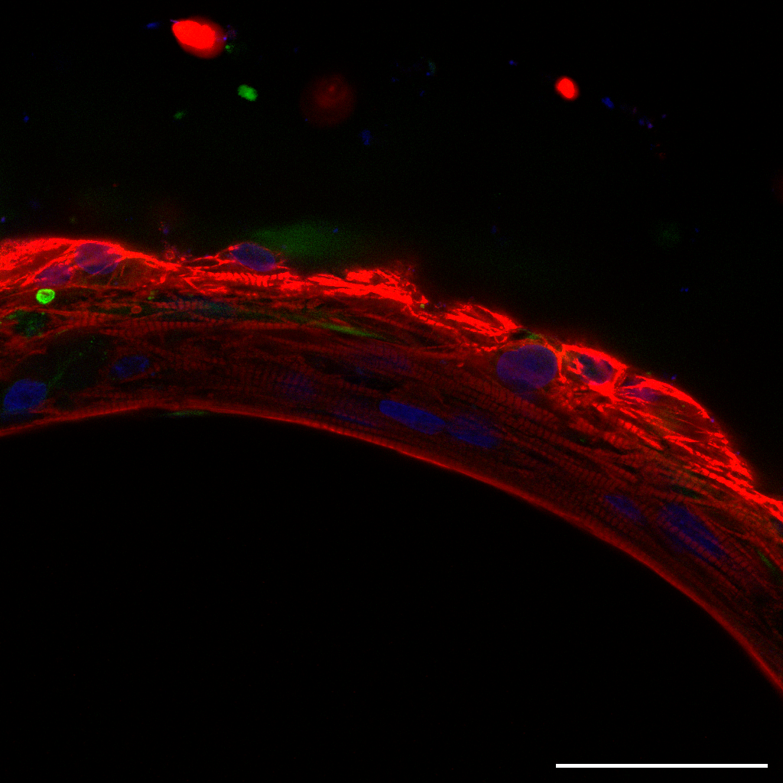
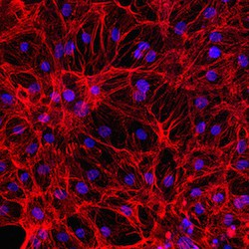
Improved maturation: striated and elongated fibers
2D monolayer of iPSC CMs
SmartHeart Tissue
50 μm
Seguret et al (2023) A versatile high-throughput assay based on 3D ring-shaped cardiac tissues generated from human induced pluripotent stem cell derived cardiomyocytes eLife 12:RP87739
Notes:
Functional assays or gene markers assessed by qt-PCR

Slide 12
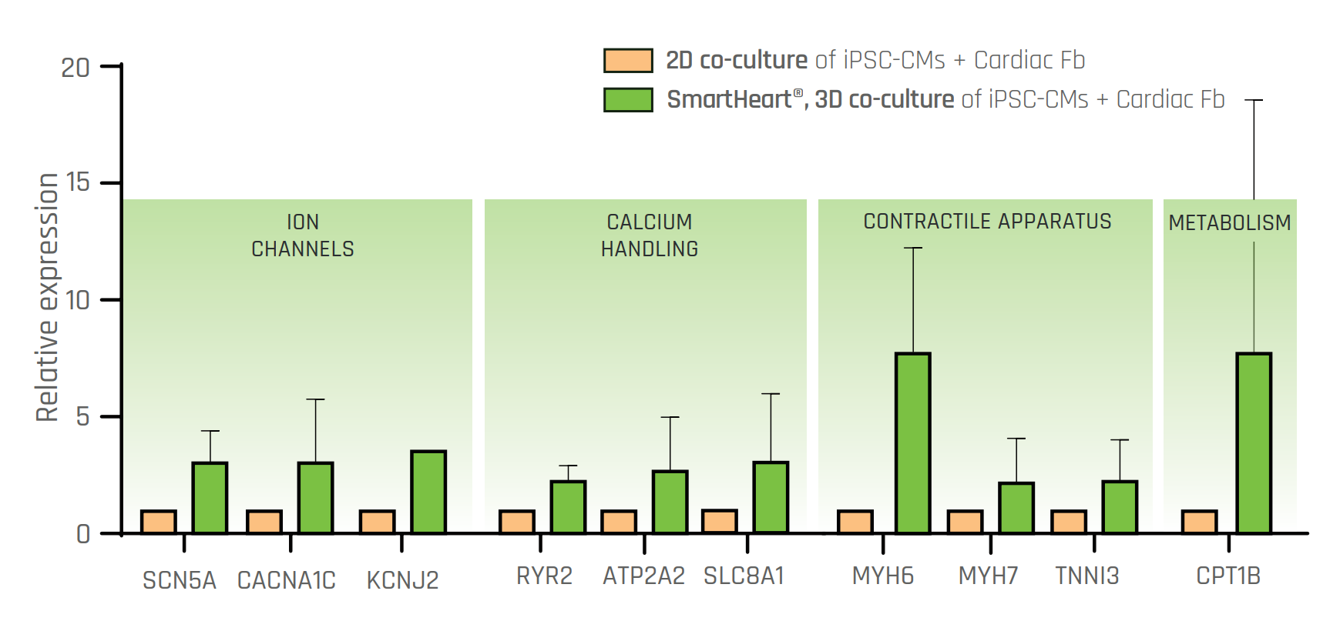
Comparative RT-qPCR – 2D vs 3D SmartHeart tissues
15 DAYS OF CULTURE ; 65000c/well ; ratio 3:1 ; N = 3 independent experiments
Notes:
SCN5A - Voltage gated sodium channel (critical role in the initiation and propagation of action potentials)
CACNA1C - Encodes the α₁C subunit of the L-type voltage-gated calcium channel. This channel is crucial for mediating calcium influx
KCNJ2 - encodes the Kir2.1 potassium channel, an inward-rectifier channel that helps stabilize the resting membrane potential in excitable cells such as those in the heart and skeletal muscle.
RYR2 - Ryanodine receptor 2 (regulates calcium ion release during excitation-contraction coupling)
ATP2A2 - encodes the sarco/endoplasmic reticulum Ca²⁺-ATPase 2 (SERCA2), a pump that transports calcium ions from the cytosol into the sarcoplasmic or endoplasmic reticulum.
SLC8A1 gene encodes NCX1, the sodium-calcium exchanger 1 - crucial for removing calcium from the cytosol after each heartbeat, aiding muscle relaxation.
MYH6 – encodes for alpha heavy chain cardiac myosin
MYH7 - encodes the β-myosin heavy chain
TNNI3 – encodes for cardiac troponin I
CPT1B - Carnitine Palmitoyl transferase 1B (crucial role in the metabolism of long-chained fatty acids)
Housekeeping gene – GAPDH - glyceraldehyde-3-phosphate dehydrogenase. It is a key enzyme in glycolysis, catalyzing the conversion of glyceraldehyde-3-phosphate into 1,3-bisphosphoglycerate, with the concurrent reduction of NAD⁺ to NADH. In addition to its central metabolic role, GAPDH is commonly used as a housekeeping gene in molecular biology due to its consistent expression across various cell types and conditions. This makes it a popular internal control for gene expression studies.

Slide 13
Cardiac Safety
Examples of CiPA and Inotropic drugs

Slide 14
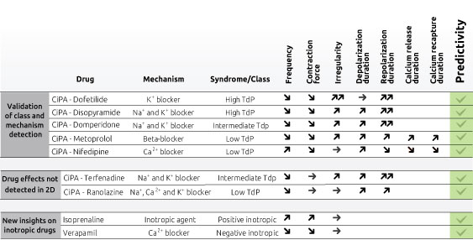
Examples of CiPA and Inotropic drugs on SmartHeart model

Slide 15
Cardiac Efficacy/Disease modeling
Emery Dreifuss Muscular Dystrophy
leading to DCM

Slide 16
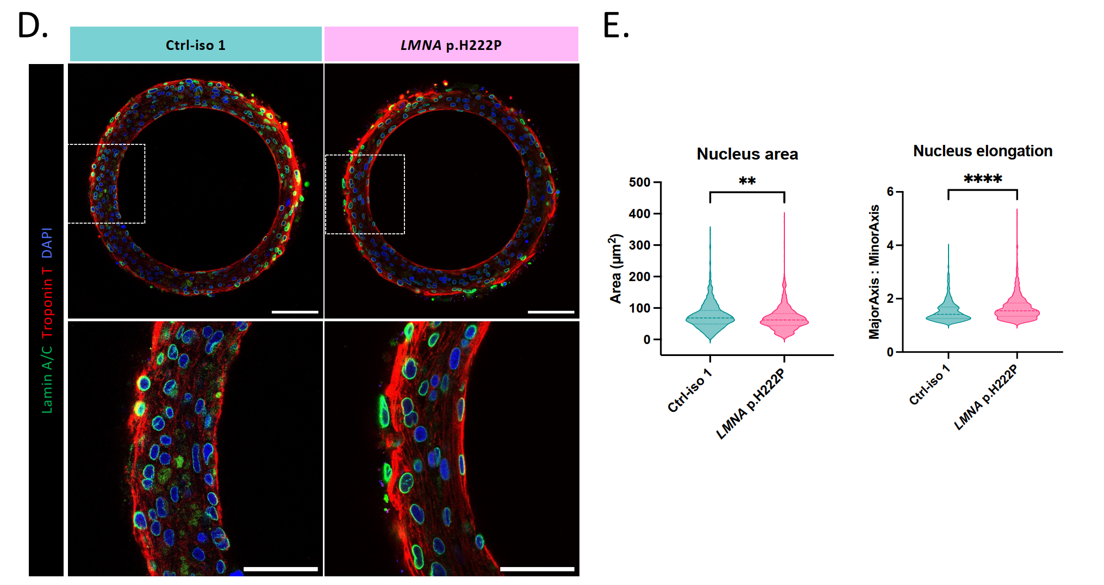
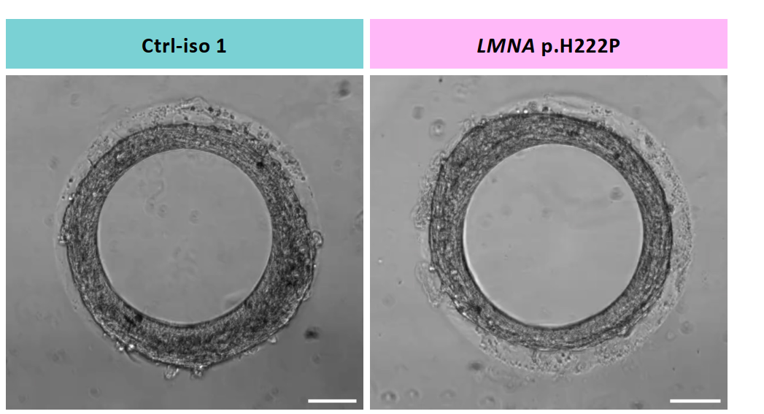
Disease modeling – Emery Dreifuss Muscular Dystrophy leading to DCM
Emery Dreifuss Muscular Dystrophy
LMNA p.H222P mutant and a CRISPR/Cas9 corrected isogenic control hiPSCs clones were differentiated into cardiomyocytes (hiPSC-CMs).
The p.H222P lamin A/C mutation induces heart failure via impaired mitochondrial calcium uptake in human cardiac laminopathy
Magali Seguret, Charlène Jouve, Andrea Ruiz-Velasco, Lucille Deshayes, Zoheir Guesmia, Céline Pereira, Karim Wahbi, Jérémy Fauconnier, Gisèle Bonne, Antoine Muchir, Jean-Sébastien Hulot
bioRxiv 2024.08.21.609073; doi: https://doi.org/10.1101/2024.08.21.609073

Slide 17
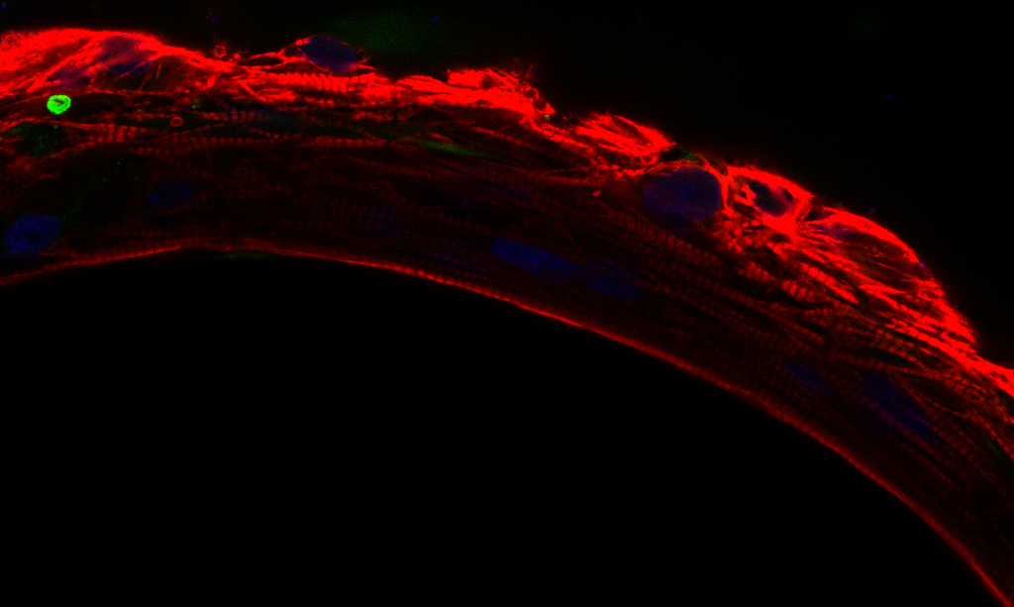

What does 4Dcell offer?
Ready to use consumables, protocols & software
In house fee for services

